Slide 1
Django - Implementing User Signup and Login
AMI PATEL

Slide 2
Contents
Creating a signup form
Handling user creation errors
Showing whether a user is logged in
Implementing the logout functionality
Implementing the login functionality

Slide 3
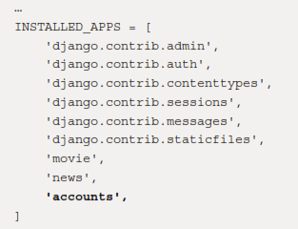
Creating a signup form
Since a signup account doesn't belong to the movie or news app, let's create a dedicated app called accounts for it. In the Terminal, run the following:
python manage.py startapp accounts
Make sure to add the new app to INSTALLED_APPS in /moviereviews/settings.py:

Slide 4
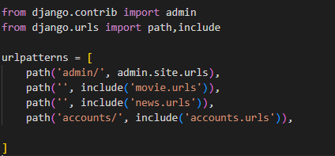
create a project-level URL for the accounts path in /moviereviews/urls.py:

Slide 5
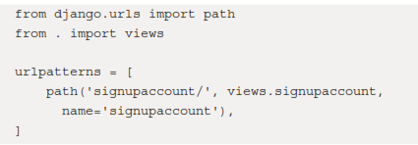
We will put all the paths related to the accounts app (for example, signup, login, and logout) in its own urls.py – that is, /accounts/urls.py (create this file with the following code):

Slide 6
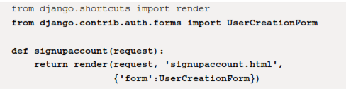
create def signupaccount in /accounts/views.py with the following code in bold:

Slide 7
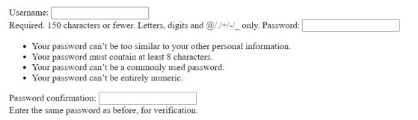
We will import UserCreationForm, which Django provides to easily create a signup form to register new users. Django forms are a vast topic in itself, and we will see how powerful they can be. We pass in the form to signupaccount.html.
Next, create /accounts/templates/signupaccount.html and simply fill in the following:
{{ form }}
Run your app and go to localhost:8000/accounts/signupaccount.
You will see a form with three fields – username, password1, and password2

Slide 8
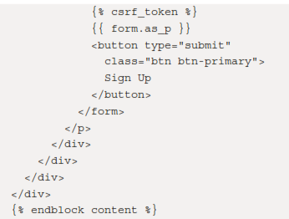
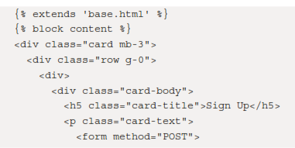
improve the styling by having signupaccount.html extend base.html.We will also wrap the fields in a form tag and have a Submit button. Replace the entire /accounts/templates/signupaccount.html with the following:

Slide 9
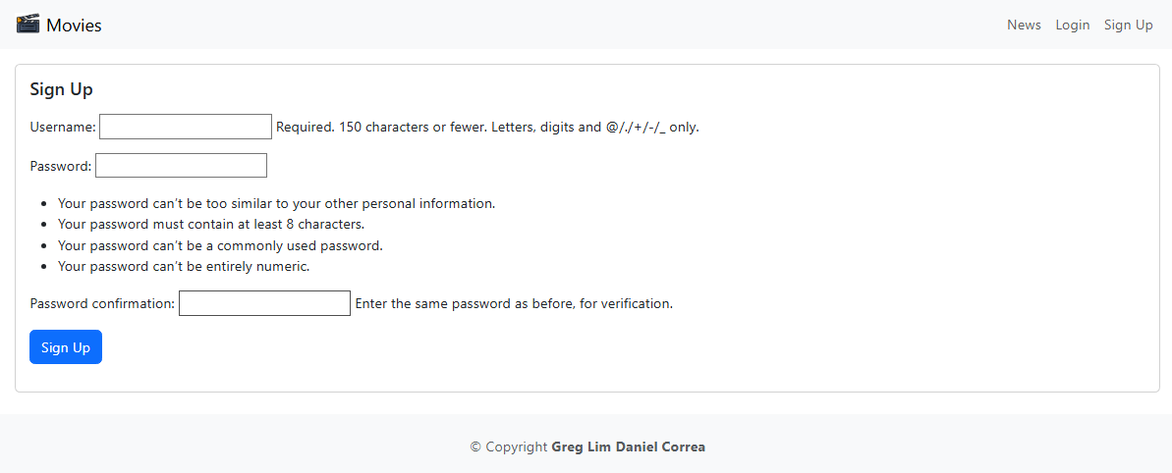
localhost:8000/accounts/signupaccount
let's see how to handle the request and create a user in admin when the user submits the signup form.

Slide 10
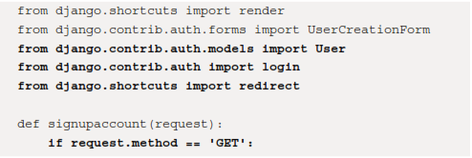
Creating a user
When the user submits the signup form, we will have to handle the request and create a user in admin.
Add the following in bold in /accounts/views.py:

Slide 11
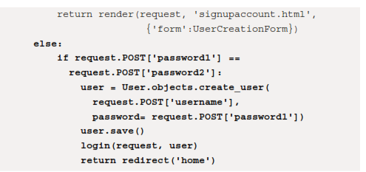
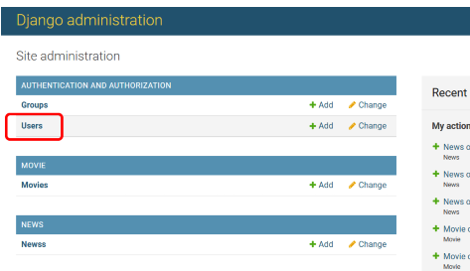
/accounts/views.py

Slide 12
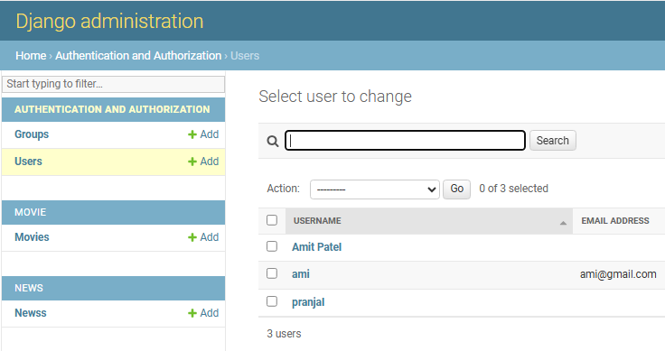
Run your app now and go to localhost:8000/accounts/signupaccount. Create a user, and you will see the new user added to admin.

Slide 13
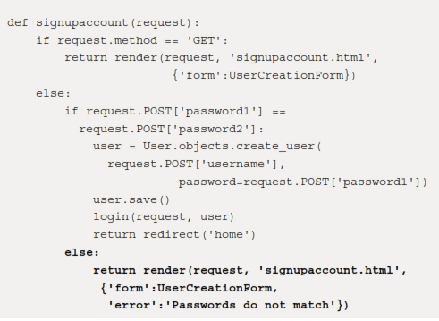
Handling user creation errors
Checking whether passwords do not match
/accounts/views.py:

Slide 14
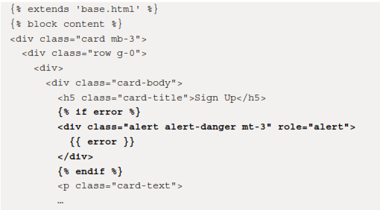
If the passwords don't match, we render the user back to signupaccount.html and also pass in an error message, Passwords do not match.

Slide 15
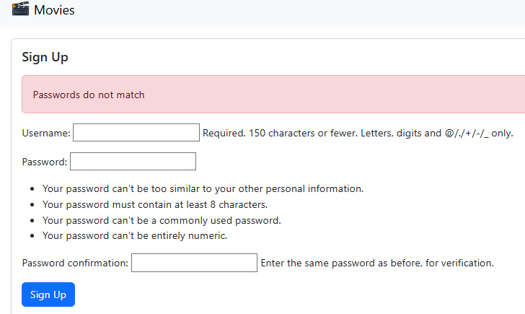

Slide 16
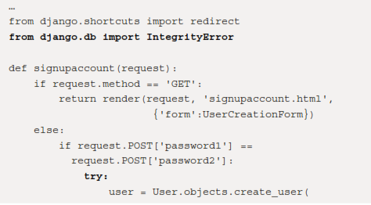
Checking if a username already exists
include this code in /accounts/views.py

Slide 17
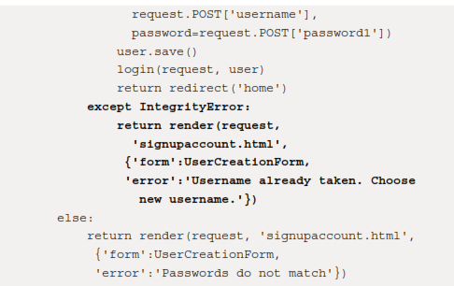
/accounts/views.py

Slide 18
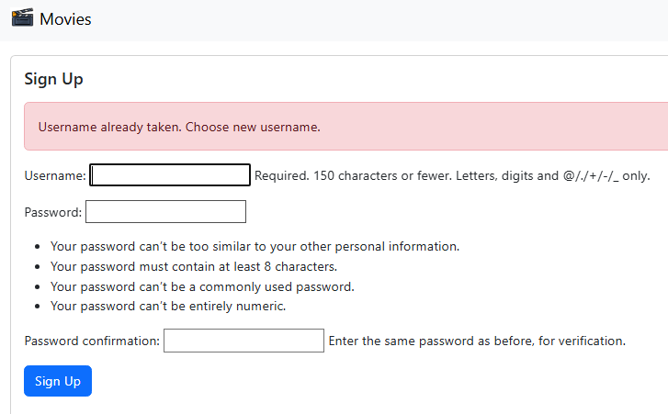
We will import IntegrityError, and using try-except, we will catch IntegrityError when it is thrown (in the case of a username already existing, as shown:

Slide 19

Showing whether a user is logged in
After a user has signed up and logged in, we are still showing the Login and Sign Up buttons in the navbar:
For logged-in users, we should be hiding these buttons and showing the Logout button instead.
To do so, let's go to our base template.

Slide 20
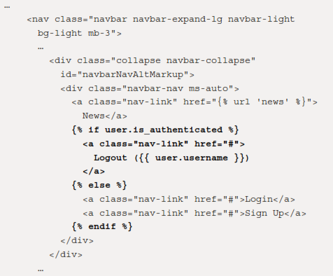
In moviereviews/templates/base.html, add the following code in bold:

Slide 21
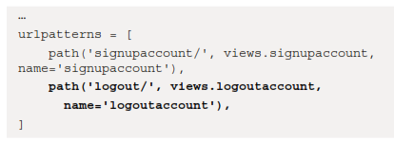
Implementing the logout functionality
Create the logout path in /accounts/urls.py with the following in bold:

Slide 22
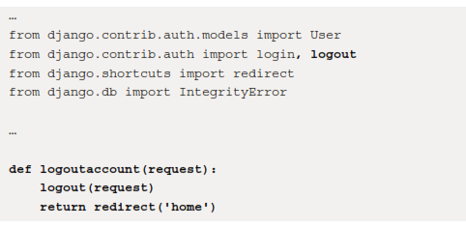
In /accounts/views.py, implement the logoutaccount function with the following in bold:
We then need to have <a href> in the logout button call the logout path. We also have
the signup button call the signupaccount path.

Slide 23


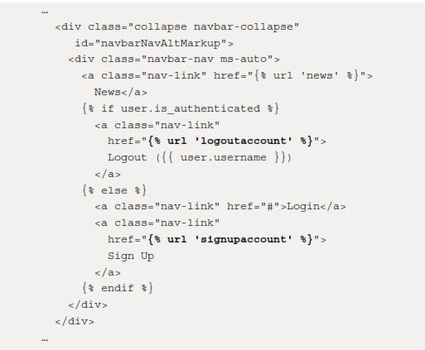
in moviereviews/templates/base.html, add the following in bold:

Slide 24

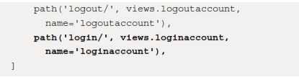
Implementing the login functionality
Create a login path in /accounts/urls.py:

Slide 25
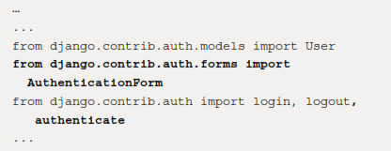
In /accounts/views.py, implement loginaccount with the following in bold:

Slide 26
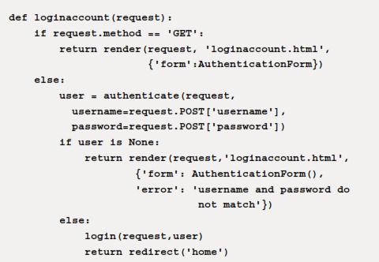
/accounts/views.py

Slide 27

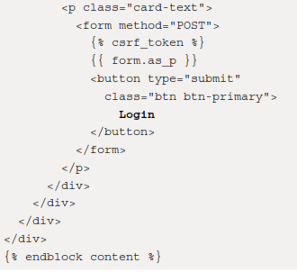
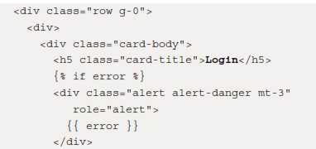
Create the new file, accounts/templates/loginaccount.html, copy the markup from accounts/templates/signupaccount.html, and change the labeling from 'Sign Up' to 'Login’:

Slide 28
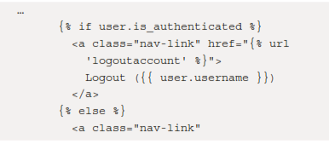
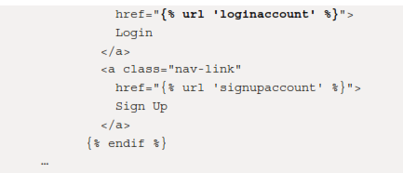
Finally, in moviereviews/templates/base.html, we set href for loginaccount:

Slide 29
Thank you

